Slide 1
Global Computer
Welcome To
Institute
Redg By : Sindh Board of Technical Education

Slide 2

Information Technology (I.T)
Information technology (IT) is the use of any computers, storage, networking and other physical devices, infrastructure and processes to create, process, store, secure and exchange all forms of electronic data.

Slide 3
Some Of IT Field
1
Software Development
2
3
IT Project Manager
Computer Network Architects
4
Web Developer
5
Network and Computer System Administrators
6
Database Administrator

Slide 4
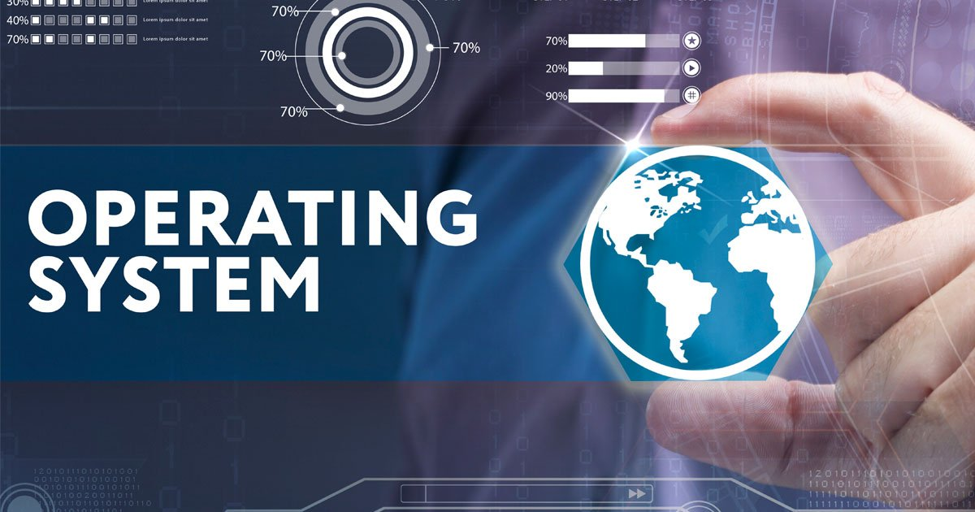
Operating System (O.S)
An Operating System (OS) is an interface between a computer user and computer hardware. An operating system is a software which performs all the basic tasks like file management, memory management, process management, handling input and output, and controlling peripheral devices such as disk drives and printers.

Slide 5
Level 1
Access
PowerPoint
Excel
MS Office
Word

Slide 6
Web Design
Photoshop
Flash
Dreamweaver
OR
VS Code
Level 2

Slide 7
Project Books Of CIT
Word
Excel
Photoshop
Ms Word Project Book
Ms Excel Project Book
Adode Photoshop Project Book

Slide 8
Level 1
Powerpnt
Excel
Access
Word
Presentation Software
Documentation Software
Calculation Software
Database Software

Slide 9
Level 2
Photoshop
Flash
Dreamweaver
Editing & Designing Software
Animation Software
Coding Software
VS code
Coding Software

